Slide 1
MY PRESENTATION
BY: LEAH

Slide 2
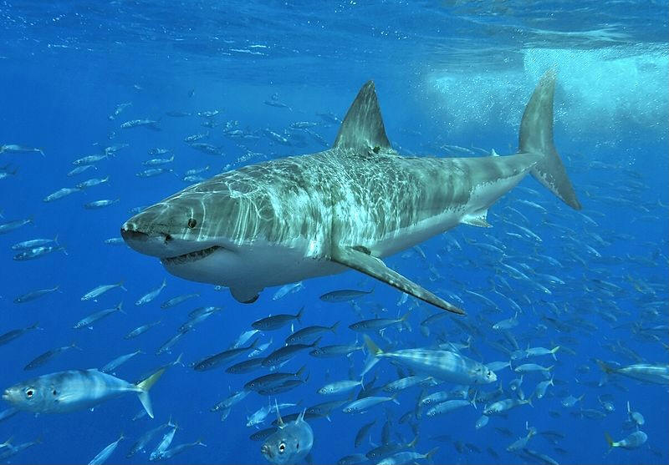
DISAPPEARING SHARKS

Slide 3
BASIC FACTS
Sharks belong to a family of fish that have skeletons made of cartilage, a tissue more flexible and lighter than bone. They breathe through a series of five to seven gill slits located on either side of their bodies. All sharks have multiple rows of teeth, and while they lose teeth on a regular basis, new teeth continue to grow in and replace those they lose.
Shark ‘skin’ is made up of a series of scales that act as an outer skeleton for easy movement and for saving energy in the water. The upper side of a shark is generally dark to blend in with the water from above and their undersides are white or lighter colored to blend in with the lighter surface of the sea from below. This helps to camouflage them from predators and prey.

Slide 4
DIET
Most species of shark eat things like fish, crustaceans, mollusks, plankton, krill, marine mammals and other sharks. Sharks also have a very acute sense of smell that allows them to detect blood in the water from miles away.

Slide 5
POPULATION
It is difficult to estimate population numbers since there are many different species spanning a large geographic area. However, overall shark numbers are on the decline due to the many threats they face in the wild.

Slide 6
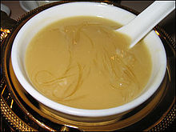
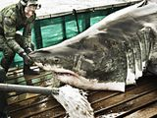
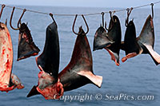
THREATS TO SHARKS

Slide 7
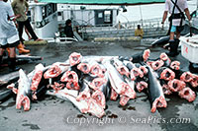
FISHERY
It is estimated that 100 million sharks are killed by people every year, due to commercial and recreational fishing.
Sharks are a common seafood in many places. Sharks are the most commonly used fish and are sold in local markets. During a four-year period from 1996 to 2000, an estimated 26 to 73 million sharks were killed and traded annually in commercial markets.[
Sharks are often killed for shark fin soup. Fishermen capture live sharks, fin them, and dump the finless animal back into the water. Shark finning involves removing the fin with a hot metal blade. The resulting immobile shark soon dies from suffocation or predators. Shark fin has become a major trade within black markets all over the world. Poachers illegally fin millions each year. Few governments enforce laws that protect them.
From 1996 to 2000, an estimated 38 million sharks had been killed per year for harvesting shark fins.

Slide 8
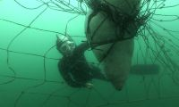
SHARK CULLING
A shark cull in Western Australia killed dozens of sharks in 2014, mostly tiger sharks. There is an ongoing "imminent threat" policy in Western Australia in which sharks that "threat" humans in the ocean can be shot and killed.
Sharks are targeted and killed in large numbers by using nets and drum lines, under a "shark control" program—this program has also inadvertently killed large numbers of other animals such as dolphins.
This program using nets and drum lines has been criticized for killing wildlife while having no proven results of keeping people safe.

Slide 9
POLLUTION
Other threats include habitat alteration, damage and loss from coastal development, pollution and the impact of fisheries on the seabed and prey species. The 2007 documentary, Sharkwater exposed how sharks are being hunted to extinction.

Slide 10
WHY PROTECT SHARKS
Sharks play a vital role in the oceans in a way that the average fish does not.
Most sharks serve as top predators at the pinnacle of the marine food pyramid, and so play a critical role in ocean ecosystems.
Directly or indirectly they regulate the natural balance of these ecosystems, at all levels, and so are an integral part of them.
As they usually hunt old, weak or sick prey, they help to keep the prey population in good condition, healthy and strong, enabling these more naturally fit animals to reproduce and pass on their genes.
The effects of removing sharks from ocean ecosystems, although complex and rather unpredictable, are very likely to be ecologically and economically damaging.

Slide 11
DON’T KILL OR EAT SHARKS
Sharks are being fished faster than they can recover
Killing sharks affects the ecosystem
Shark meat contains toxic Mercury
Sharks are worth more alive than dead
Sharks are good indicators of ecosystem health

Slide 12
SOLUTION
You can help support healthy oceans and save the Sharks by joining a foundation to protect these species.

Slide 13
APPRECIATE
Teach people why Sharks are important and we should take some time to appreciate these wonderful and beautiful creatures of the sea.

Slide 14
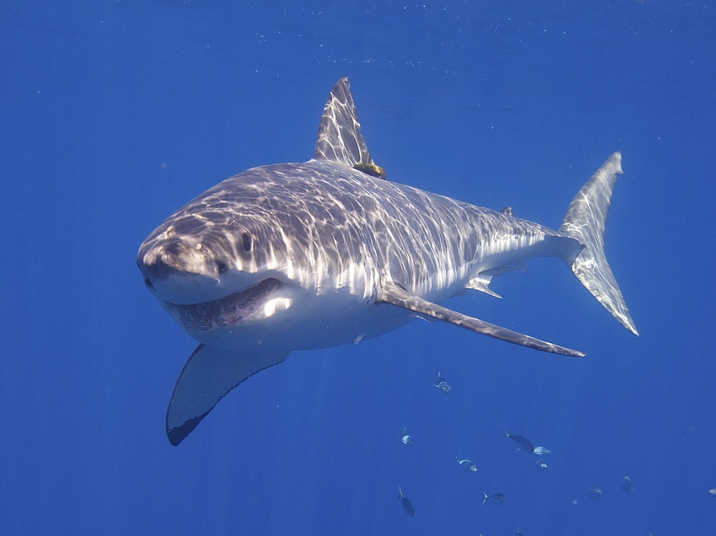
IMAGES

Slide 15
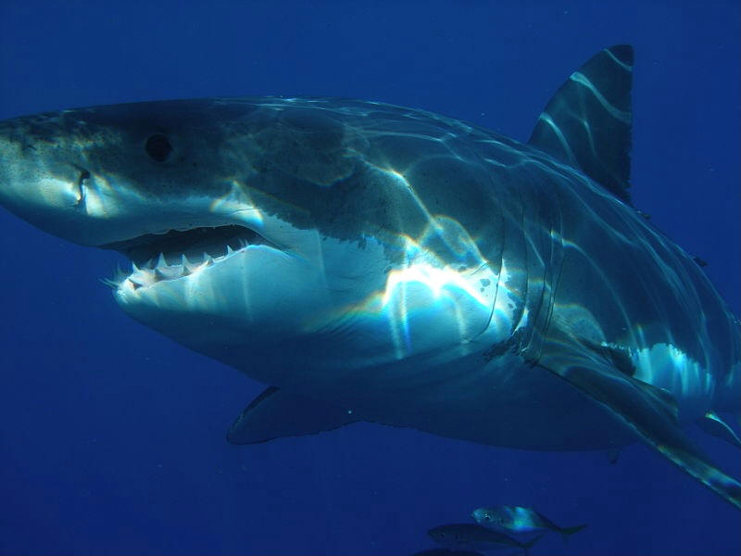

Slide 16
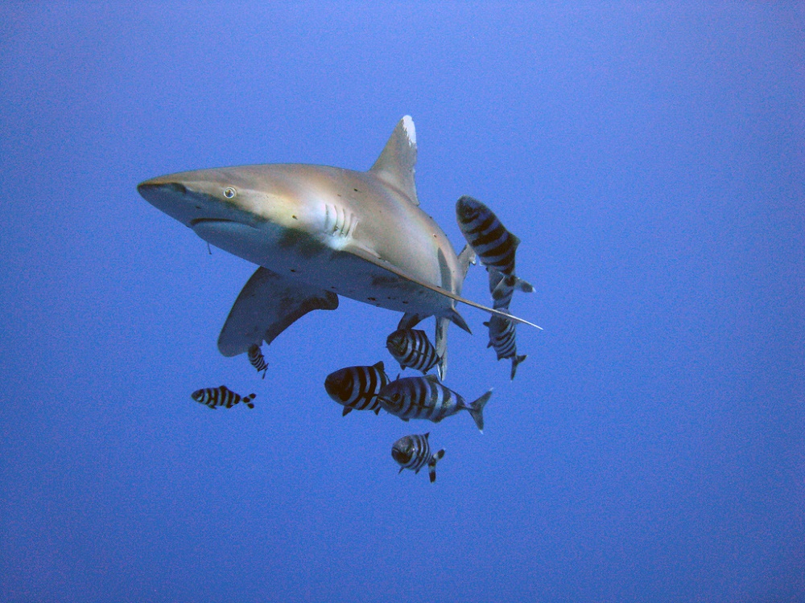

Slide 17
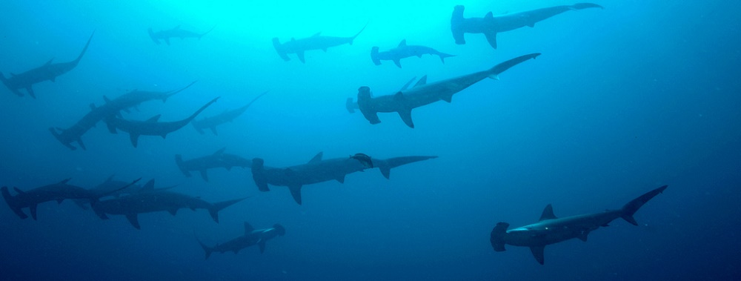

Slide 18
